Slide 1

i-Property Web Scrapping
Nov 2021

Slide 2
1.0 Business Understanding
Model Name: | i-Property Web Scrapping
Background: | Using python to extract property price data based on address and postcode of Maybank Mortgage customer living in Klang Valley. Property data will then will be match back to all Maybank customer that live in Kang Valley (around 5 Mill customer) using Fuzzy Logic to match string data.
Objective: | To identify price of property that customer living in To use as proxy for better targeting of product based on customer profile living in different type of property
Impact on Business: | To target the right and quality customers and reduce effort on targeting the wrong segment.
Other Business Rule Criteria: | All customer data in Klang Valley with address
Model Build Date: | 20 August 2021

Slide 3
2.0 Framework
Mortgage Data
PJ Customer (# 86,952) -Address -Postcode -Mortgage Price *Term Extraction
i-Property Data
Klang Valley (# 180K) -Address -Postcode -Price *Web Scrapping
Matching
-Match by Postcode & String -Match by String only *accuracy based on ±50% from real property price
Customer Data
Klang Valley Customer (# 5 Mill) -Address -Price *Term Extraction
Apply Model

Slide 4



3.0 Data Preparation
1. Term Replacement
2. Term Removal
3. Term Extraction
our biggest assets
Lowercase and replace some common words that often written in shortform for standardization. Examples:
Jln
Tgkt
Lvl
Sek
Condo
Remove unrelated terms
Single terms: ground floor, first floor, a,b,c
Paired terms: lot #, tingkat #, block #
Company Name: all terms before berhad, holdings
Terms after postcode (area,state,country)
Remove if terms (all the words betw “,”) is numbers
Extract based on terms (all the words betw “,”)
Priority based extraction:
1st prio: condominium, apartment etc (add mini terms after)
2nd prio: kg, center, taman
3rd prio: terms before jalan
4th prio: the jalan terms (add mini terms after)
5th prio: the seksyen
Multiple terms may be extracted from a single address and are extracted based on priority.
Eg: B8-11-10 BLK B, ARMANEE CONDO, JLN PJS 9/1, TMN MAYANG, 47820 PETALING JAYA SELANGOR
'armanee condominium’
'armanee’
'taman mayang’
'jalan pjs 9/1’
'jalan pjs 9’
Postcode = 47820
b8-11-10 block b , armanee condominium , , jalan pjs 9/1 , taman mayang , 47820 petaling jaya selangor
armanee condominium , , jalan pjs 9/1 , taman mayang
47820

Slide 5

4.0 Methodology – String Matching
3. Term Extraction
4. String Matching
'armanee condominium’
'armanee’
'taman mayang’
'jalan pjs 9/1’
'jalan pjs 9’
Postcode = 47820
Address | Postcode | Property Price
Armanee, Damansara Damai | 47820 | 500,000
Armanee Terrace | 47820 | 1,050,000
Armanee Terrace | 47820 | 700,000
Extracted Output:
-Q1 Price
-Mean Price
-Median Price
-Count Found

Slide 6
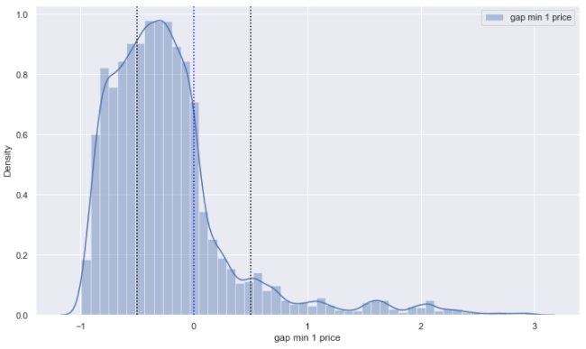
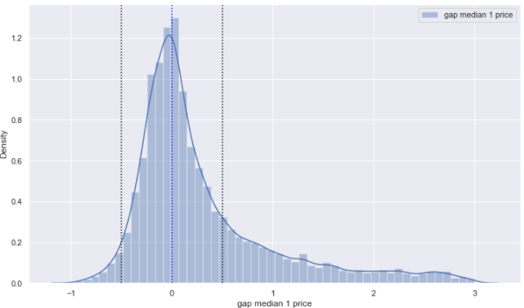
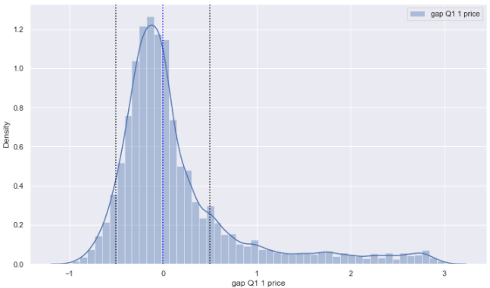
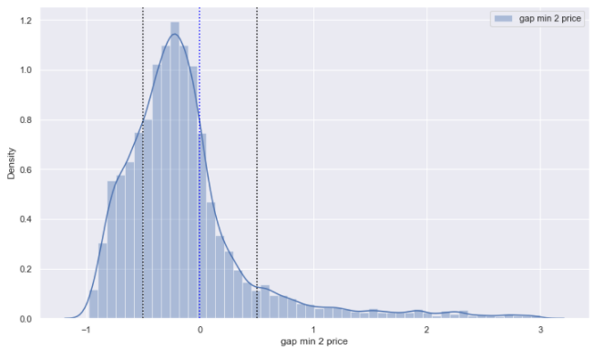
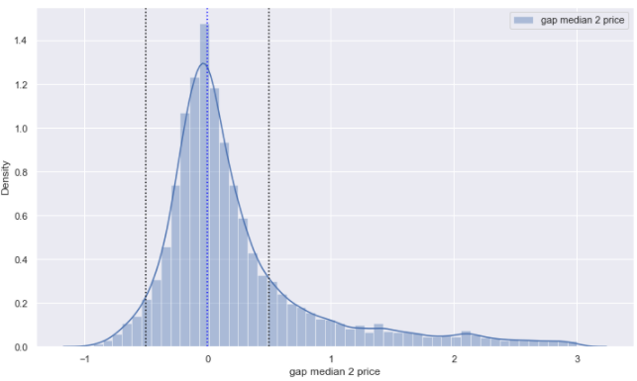
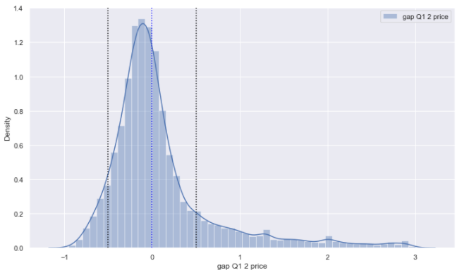
5.0 Output Analysis
Approach
Minimum Price
Median Price
Q1 Price
Approach 1
String Matching
(79.13% matching)
Accuracy Value
±20% = 24.02%
±50% = 55.65%
Accuracy Value
±20% = 38.35%
±50% = 64.23%
Accuracy Value
±20% = 37.77%
±50% = 70.72%
Approach 2
String and Postcode Matching
(43.39% matching)
Accuracy Value
±20% = 29.76%
±50% = 64.29%
Accuracy Value
±20% = 42.91%
±50% = 69.92%
Accuracy Value
±20% = 42.00%
±50% = 72.89%
Q1 will be used as price of the property since it give highest accuracy for both approaches
Gap 50% will be used since it give more observations and cover property fluctuation in price since 2014

Slide 7
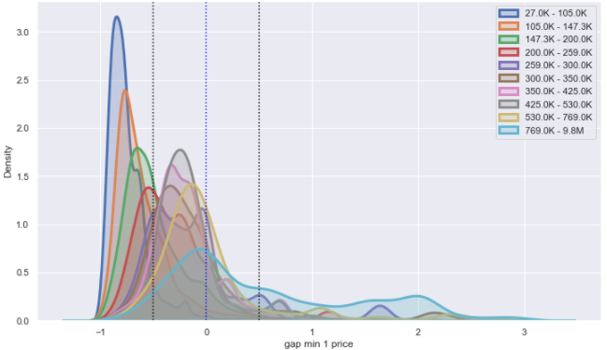
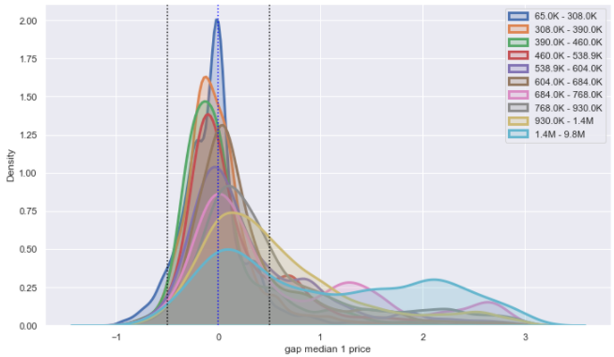
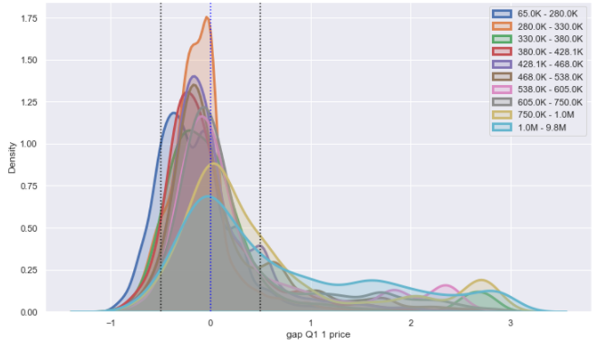
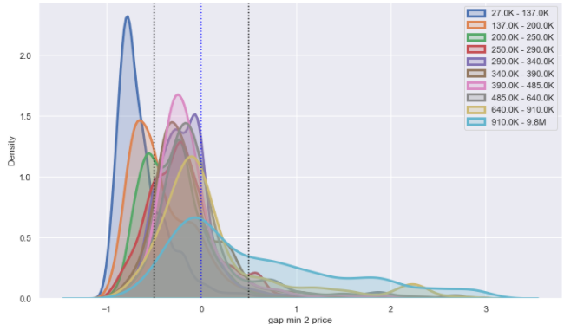
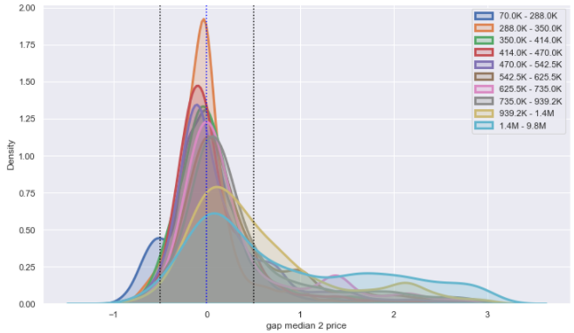
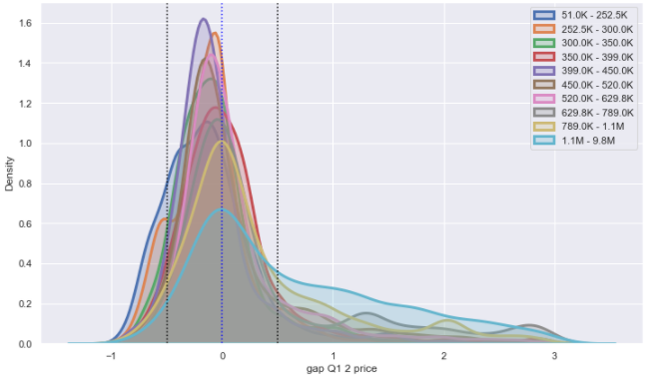
5.0 Output Analysis
Approach
Minimum Price
Median Price
Q1 Price
Approach 1
String Matching
(79.13% matching)
Accuracy Value
±20% = 24.02%
±50% = 55.65%
Accuracy Value
±20% = 38.35%
±50% = 64.23%
Accuracy Value
±20% = 37.77%
±50% = 70.72%
Approach 2
String and Postcode Matching
(43.39% matching)
Accuracy Value
±20% = 29.76%
±50% = 64.29%
Accuracy Value
±20% = 42.91%
±50% = 69.92%
Accuracy Value
±20% = 42.00%
±50% = 72.89%
Q1 will be used as price of the property since it give highest accuracy for both approaches
Gap 50% will be used since it give more observations and cover property fluctuation in price since 2014

Slide 8
6.0 Validation Output – Approach 1
Total Observation Count: | 68,803
Success Count (Y): | 48,658 | 70.72%
Success Definition: | I-property price have less than 50% gap than the mortgage price
Non-Success Count (N): | 20,145 | 29.22%
Non-Success Definition: | I-property price have more than 50% gap than the mortgage price
Observation Data: | Mortgage price from 2014 - Jun 2021 (7.5 Years)
Prediction Data: | Customer Data in Klang Valley (5M)
2016 - June 2021
Mortgage Data
n = 86,952
There are 87k mortgage data
Out of 87k, 79.1% of that returns a result (returns a price for their property) and identified as model base
Returns match
n = 68,803
(79.1%)
20.9%
<50% gap
n = 48,658
(70.72%)
Out of 68k, 70.72% have their mortgage price and the i-property price have less than 50% price difference
29.28%

Slide 9
6.0 Prediction Result (Post Development)
Total Observation Count: | 5,122,775
Success Count (Y): | 4,194,734 | 81.88%
Success Definition: | Customers that can match address with i-Property data
Non-Success Count (N): | 928,041 | 18.12%
Non-Success Definition: | Sample of customers who do not match with i-property data
Prediction Data: | Customer Data in Klang Valley (5M) from Customer Address Table
Customer Data
n = 5,122,775
5 Mil customer data extracted from database to serve as the base
Returns match
n = 4,194,734
81.88%
Out of 5 Mil, 4.2Mil returns a result (returns a price for their property)
18.12%
Non-retails
Retails
n = 3,108,002
(74.09%)
Out of 4.2 Mil,3.1 Mil are retail customers
25.91%
Notes:
No match = 928,041 (18.12%)
Smebb = 253,070 (6.03%)
Others = 833,662 (19.87%)

Slide 10
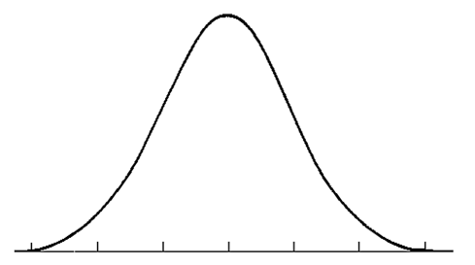
7.0 Used Case - Background
Customer Address Table
Klang Valley Customer # 5,122,774 # 4,194,734 with Property Price
Persona Table/Retails Table
All Data # 11,670,125
Accuracy Gap Definition
Match Data
Klang Valley Customer # 3,761,793 Match with Persona Data # 3,108,002 with Property Price
-150% -100% -50% 0% 50% 100% 150%
Low Property Price | Middle Property Price | High Property Price
Bottom 20% # 655,539 Cust < RM310K | Middle 60% # 1,846,719 Cust RM 310K – RM 765K | Top 20% # 605,744 Cust > RM 765K
50% Accuracy Gap

Slide 11
7.0 Used Case – Distribution (# 3,108,002)
* Only 2,733,895 (87.96%) Cust are belong to MASS segment with income group and property price
Low Price
< RM310K
Middle Price
RM 310K – RM 765K
High Price
> RM 765K
Total
479,826 (15.44 %) | 1,214,387 (39.07 %) | 348,291 (11.21 %) | 2,042,504 (65.72 %)
97,716 (3.14 %) | 321,070 (10.33 %) | 101,552 (3.27 %) | 520,338 (16.74 %)
22,155 (0.71 %) | 95,495 (3.07 %) | 53,403 (1.72 %) | 171,053 (5.50 %)
18,046 (0.58 %) | 52,440 (1.69 %) | 16,042 (0.52 %) | 86,528 (2.78 %)
37,796 (1.22 %) | 163,327 (5.26 %) | 86,456 (2.78 %) | 287,579 (9.25 %)
MASS
(B40)
MASS
(M40)
MASS
(T20)
MASS
(Unknown Income)
HAB

Slide 12
7.0 Used Case – Price Sensitive Customer
Low Price
< RM310K
Middle Price
RM 310K – RM 765K
High Price
> RM 765K
479,826 (15.44 %) | 1,214,387 (39.07 %) | 348,291 (11.21 %)
97,716 (3.14 %) | 321,070 (10.33 %) | 101,552 (3.27 %)
22,155 (0.71 %) | 95,495 (3.07 %) | 53,403 (1.72 %)
MASS
(B40)
Dependents = 132,308 (27.57%)
Youth = 55,204 (11.5%)
Income <3K = 424,933 (88.56%)
MASS
(M40)
Dependents = 40,062 (12.48%)
Youth = 1,434 (0.45%)
Income 4K-7K = 253,205 (78.86%)
MASS
(T20)
55% of these customer have IA < RM1k
55% of these customer have TFA < RM2.5k
71% have median expenses < RM3k where 31% of them concentrated at 2k-3k
45% customer fall under income 1k-2k and 32% fall under income 4k-7k
65% of customer are adult with age 31-60
65% hold exactly 1 product type with Maybank
Around 25.77% (800,896 out of 2,733,895) belong to Price Sensitive segment where this group of customer bought their house that align with their income level.
Proposed Action

Slide 13
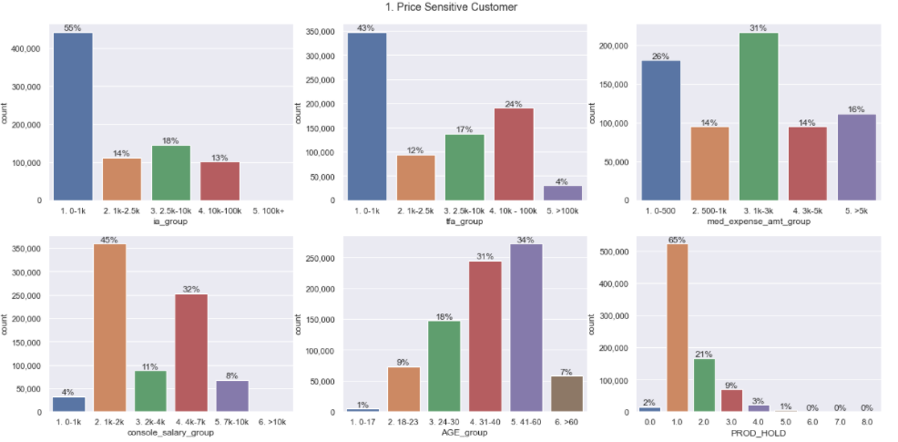
7.0 Used Case – Price Sensitive Customer

Slide 14
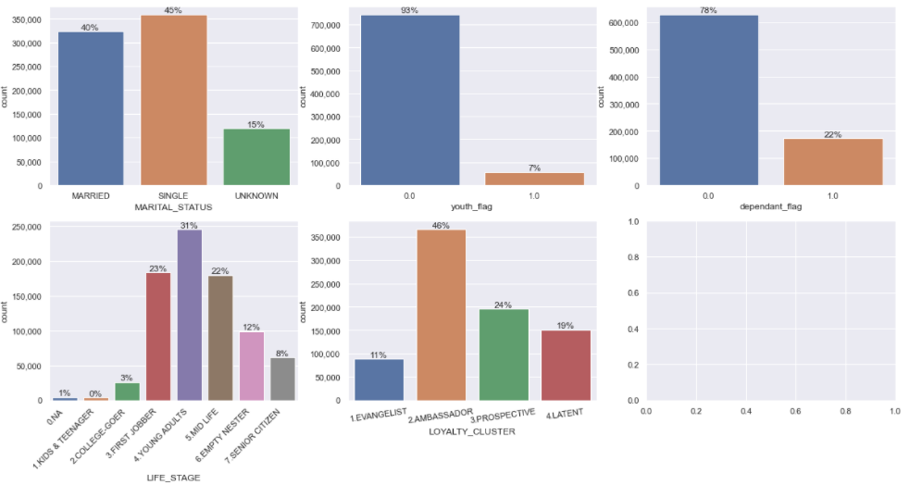
7.0 Used Case – Price Sensitive Customer

Slide 15
7.0 Used Case – High Price Property
Low Price
< RM310K
Middle Price
RM 310K – RM 765K
High Price
> RM 765K
479,826 (15.44 %) | 1,214,387 (39.07 %) | 348,291 (11.21 %)
97,716 (3.14 %) | 321,070 (10.33 %) | 101,552 (3.27 %)
22,155 (0.71 %) | 95,495 (3.07 %) | 53,403 (1.72 %)
Dependents = 366,959 (30.22%)
Youth = 145,791 (12%)
Income <3K = 1,067,211 (87.88%)
MASS
(B40)
MASS
(M40)
Dependents = 122,282 (35.21%)
Youth = 47,693 (13.73%)
Income <3K = 308,570 (88.6%)
MASS
(T20)
Dependents = 16,095 (15.85%)
Youth = 576 (0.57%)
Income 4K-7K = 76,199 (75.03%)
Around 60.87% (1,664,230 out of 2,733,895) belong to High Price Property segment where this group of customer are staying at property that are higher than their income level
This segment of group will be further split by dependency
*Dependent = Customer that are mostly (Student, Homemaker, Retiree) with no income
Notes:
Change to different profiling – dependent 0/ 1
Dependent 1

Slide 16
7.0 Used Case – High Price Property (Independent)
Low Price
< RM310K
Middle Price
RM 310K – RM 765K
High Price
> RM 765K
479,826 (15.44 %) | 847,428 (27.27 %) | 226,009 (7.27 %)
97,716 (3.14 %) | 321,070 (10.33 %) | 85,457 (2.75 %)
22,155 (0.71 %) | 95,495 (3.07 %) | 53,403 (1.72 %)
Income <3K = 718,448 (87.88%)
MASS
(B40)
MASS
(M40)
Income <3K = 191,927 (88.6%)
MASS
(T20)
Income 4K-7K = 64,421 (75.03%)
Around 42.39% (1,158,894 out of 2,733,895) belong to High Price Property (Independent ) segment where this group of customer are likely to be Secondary Maybankers
Independent High Price Property
57% of these customer have IA < RM1k
60% of these customer have TFA < RM2.5k
76% have median expenses < RM3k where 37% of them concentrated at 2k-3k
61% customer fall under income 1k-2k
66% of customer are adult with age 31-60
69% hold exactly 1 product type with Maybank
Proposed Action
Notes:
Change to different profiling – dependent 0/ 1
Dependent 1

Slide 17
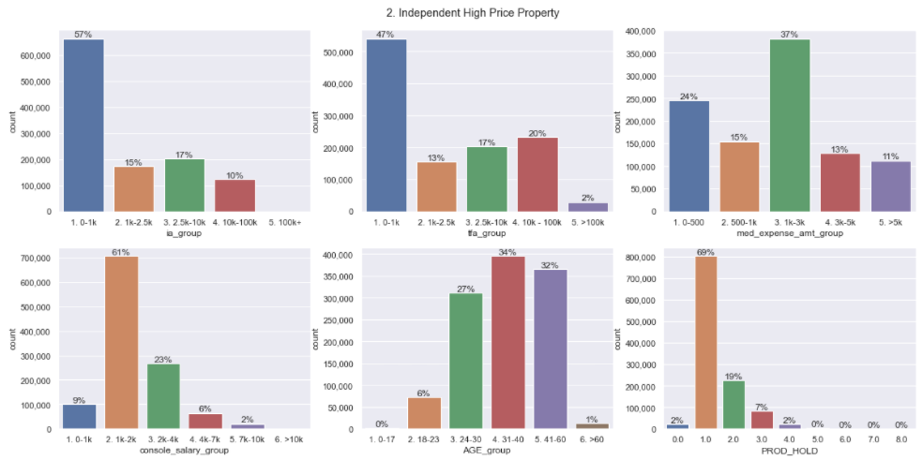
7.0 Used Case –High Price Property (Independent)

Slide 18
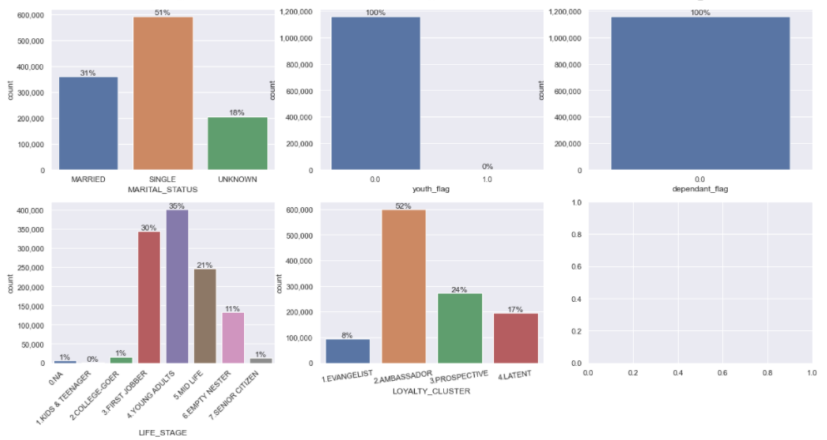
7.0 Used Case –High Price Property (Independent)

Slide 19
7.0 Used Case – Dependent Second Generation (Youth)
Low Price
< RM310K
Middle Price
RM 310K – RM 765K
High Price
> RM 765K
479,826 (15.44 %) | 366,959 (11.81 %) | 122,282 (3.93 %)
97,716 (3.14 %) | 321,070 (10.33 %) | 16,095 (0.52 %)
22,155 (0.71 %) | 95,495 (3.07 %) | 53,403 (1.72 %)
Youth = 145,780 (12%)
Income <3K = 348,763(87.88%)
MASS
(B40)
MASS
(M40)
Youth = 47,691 (39.00%)
Income <3K = 116,643 (88.6%)
MASS
(T20)
Youth = 576 (100%)
Income 4K-7K = 11,778 (75.03%)
Around 18.48% (505,336 out of 2,733,895) belong to Second Generation (Dependent) segment where this group of customer are likely stay with their parent/guardian house.
Dependent Second Generation (Youth)
62% of these customer have IA < RM1k
69% of these customer have TFA < RM2.5k
53% have median expenses < RM500
92% customer fall under income 1k-2k
34% of customer are age <23 and 33% are age >60
85% hold exactly 1 product type with Maybank
Proposed Action
Notes:
Change to different profiling – dependent 0/ 1
Dependent 1

Slide 20
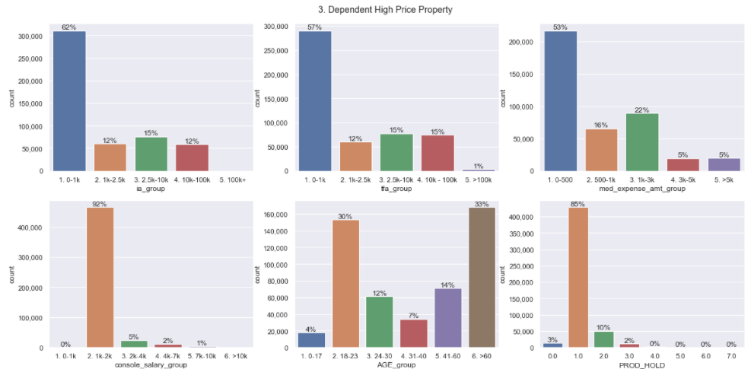
7.0 Used Case – Second Generation (Youth)

Slide 21
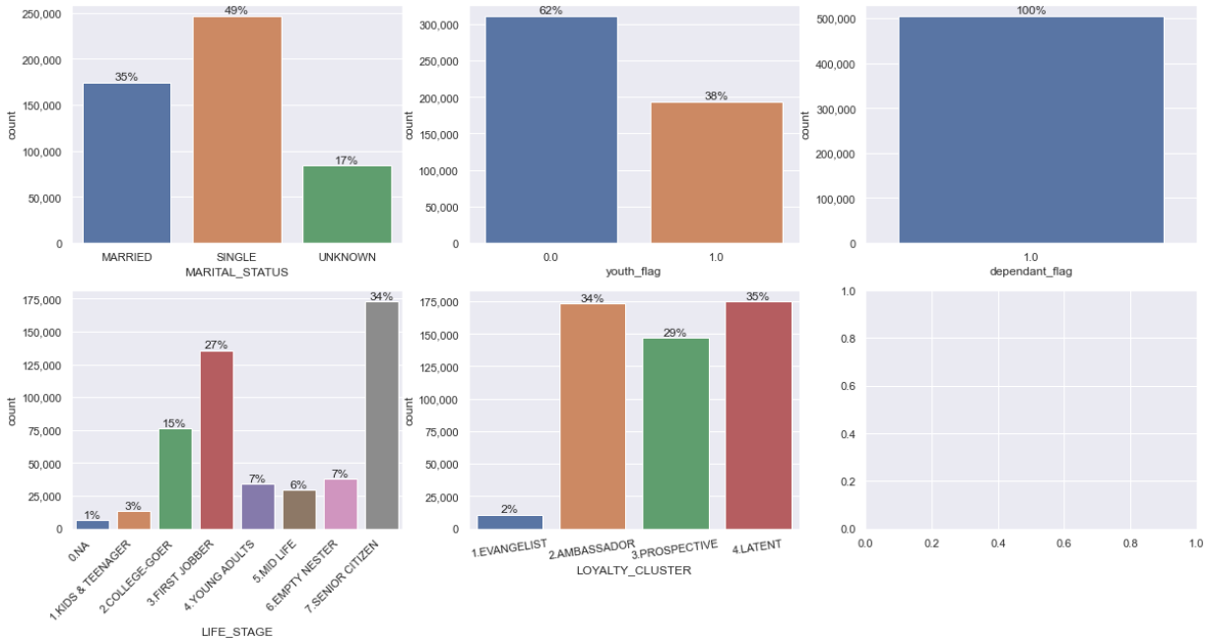
7.0 Used Case – Second Generation (Youth)

Slide 22
7.0 Used Case – Cash Rich/Investor
Low Price
< RM310K
Middle Price
RM 310K – RM 765K
High Price
> RM 765K
479,826 (15.44 %) | 1,214,387 (39.07 %) | 348,291 (11.21 %)
97,716 (3.14 %) | 321,070 (10.33 %) | 101,552 (3.27 %)
22,155 (0.71 %) | 95,495 (3.07 %) | 53,403 (1.72 %)
MASS
(B40)
Dependents = 10,739 (10.99%)
Youth = 457 (0.47%)
4K-7K = 80,602 (82.49%)
Dependents = 4,037 (18.22%)
Youth = 90 (0.4%)
>20K = 8,238 (37.18%)
MASS
(M40)
MASS
(T20)
Dependents = 18,850 (19.74%)
Youth = 246 (0.25%)
>20K = 29,576 (30.97%)
Around 7.88% (215,366 out of 2,733,895) belong to Cash Rich (Investor) segment where this group of customer are high income but stayed at relatively lower property price.
45% of these customer have IA < RM1k but 21% have IA within RM10k-RM100K
36% of these customer have TFA within RM10k-RM100K
50% have median expenses > RM3k
55% customer fall under income >10k
83% of customer are adult with age 31-60
47% hold at least 2 product type with Maybank

Slide 23
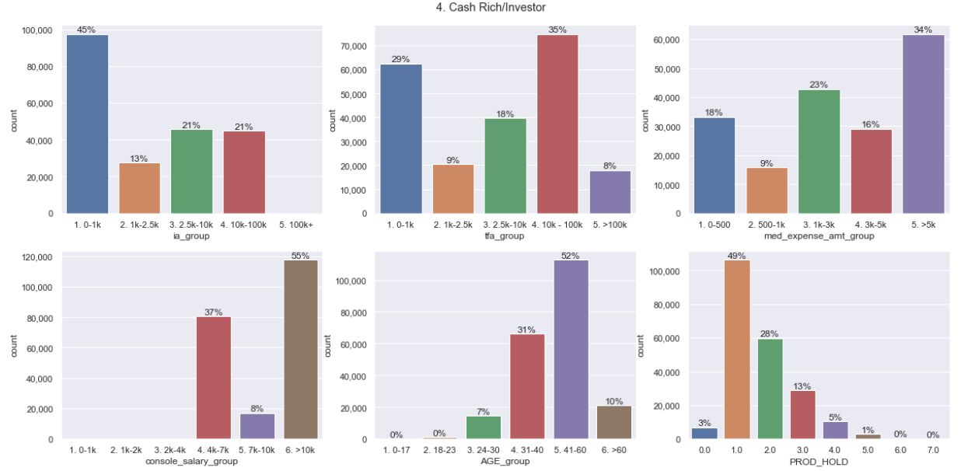
7.0 Used Case – Cash Rich/Investor

Slide 24
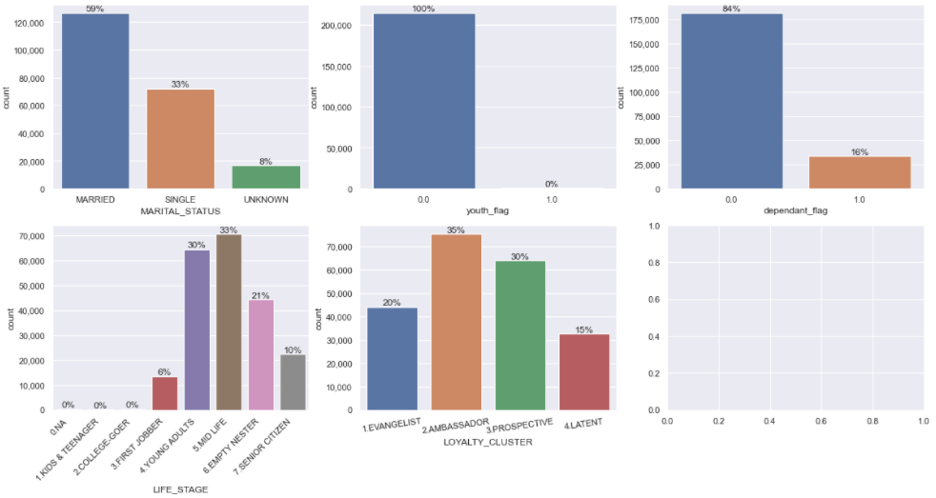
7.0 Used Case – Cash Rich/Investor

Slide 25
7.0 Used Case – Super Rich Mass Customer
Low Price
< RM310K
Middle Price
RM 310K – RM 765K
High Price
> RM 765K
479,826 (15.44 %) | 1,214,387 (39.07 %) | 348,291 (11.21 %)
97,716 (3.14 %) | 321,070 (10.33 %) | 101,552 (3.27 %)
22,155 (0.71 %) | 95,495 (3.07 %) | 53,403 (1.72 %)
MASS
(B40)
MASS
(M40)
Dependents = 13,134 (24.59%)
Youth = 125 (0.23%)
>20K = 18310 (34.29%)
MASS
(T20)
Around 1.72% (53,403 out of 2,733,895) belong to Super Rich segment where this group of customer are enjoying life with excess source of income.
43% of these customer have IA < RM1k but 27% have IA within RM10k-RM100K
37% of these customer have TFA within RM10k-RM100K
53% have median expenses > RM3k
All customer fall under income >10k
58% of customer are adult with age 41-60
45% hold at least 2 product type with Maybank
Proposed Action

Slide 26
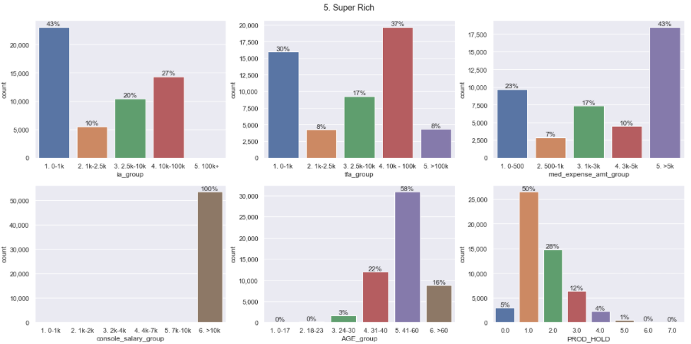
7.0 Used Case – Super Rich

Slide 27
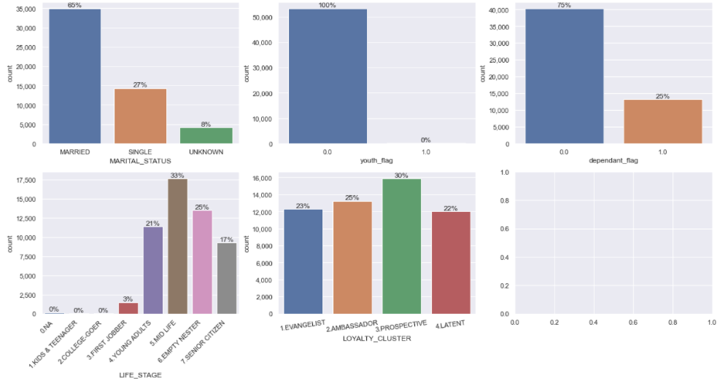
7.0 Used Case – Super Rich

Slide 28
THANK YOU

Slide 29
8.0 Next Step

Slide 30
APPENDIX

Slide 31
Used Case 1 – Potential Affluent
Segment2 | income_cat | < 310K | 310k-765k | >765k | NO PRICE | Grand Total
MASS | B40 | 479,826 | 1,214,387 | 348,291 | 467,922 | 2,510,426
 | M40 | 97,716 | 321,070 | 101,552 | 90,347 | 610,685
 | T20 | 22,155 | 95,495 | 53,403 | 28,243 | 199,296
 | UNKNOWN | 18,046 | 52,440 | 16,042 | 23,409 | 109,937
HAB |  | 37,796 | 163,327 | 86,456 | 43,870 | 331,449
? | ? | 204,478 | 650,070 | 232,184 | 274,250 | 1,360,982
Grand Total |  | 860,017 | 2,496,789 | 837,928 | 928,041 | 5,122,775
118,590 Potential Affluent:
Currently MASS segment
property with more than 765k
Is in M40 or T20
Possibly have other assets in other place

Slide 32
Used Case 2 – Cash rich/Investor
Segment2 | income_cat | < 310K | 310k-765k | >765k | NO PRICE | Grand Total
MASS | B40 | 479,826 | 1,214,387 | 348,291 | 467,922 | 2,510,426
 | M40 | 97,716 | 321,070 | 101,552 | 90,347 | 610,685
 | T20 | 22,155 | 95,495 | 53,403 | 28,243 | 199,296
 | UNKNOWN | 18,046 | 52,440 | 16,042 | 23,409 | 109,937
HAB |  | 37,796 | 163,327 | 86,456 | 43,870 | 331,449
? | ? | 204,478 | 650,070 | 232,184 | 274,250 | 1,360,982
Grand Total |  | 860,017 | 2,496,789 | 837,928 | 928,041 | 5,122,775
Possibly have a large disposable income
Offers suitable products like:
Investment
Insurance
Personal loan
119,871 potential customer:
Currently MASS segment
Own a property valued less than 310k
Is in M40 or T20

Slide 33
Used Case 3 – Campaign Prioritization
Segment | income_cat | count
MASS | B40 | 2,510,426
 | M40 | 610,685
 | T20 | 199,296
 | UNKNOWN | 109,937
 |  | 3,430,344
income_cat | < 310K | 310k-765k | >765k | NO PRICE | Grand Total
B40 | 479,826 | 1,214,387 | 348,291 | 467,922 | 2,510,426
M40 | 97,716 | 321,070 | 101,552 | 90,347 | 610,685
T20 | 22,155 | 95,495 | 53,403 | 28,243 | 199,296
UNKNOWN | 18,046 | 52,440 | 16,042 | 23,409 | 109,937
 | 617,743 | 1,683,392 | 519,288 | 609,921 | 3,430,344
Example: Campaign targeting MASS & T20
Total no of customer : 199,296
Prioritize the customer based on the Property value more than 765k first:
53,403
Followed by the others for the leads
103,801

Slide 34
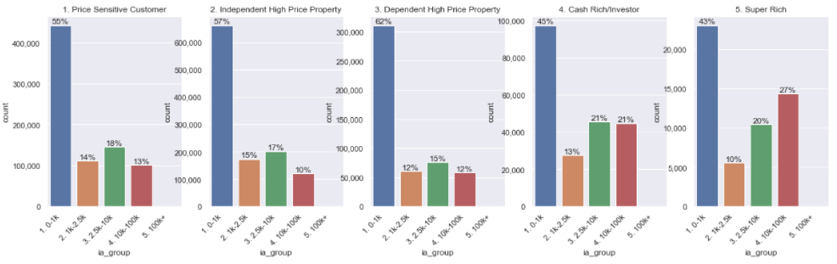
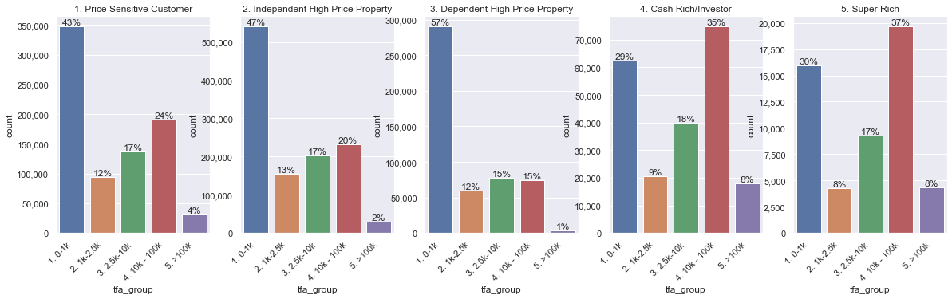
7.0 5 Profile analysis
ia
tfa

Slide 35
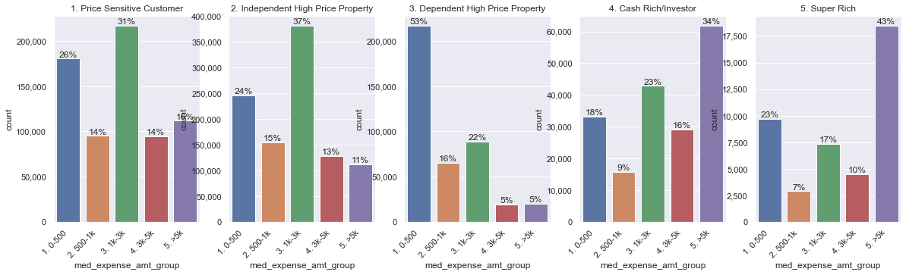
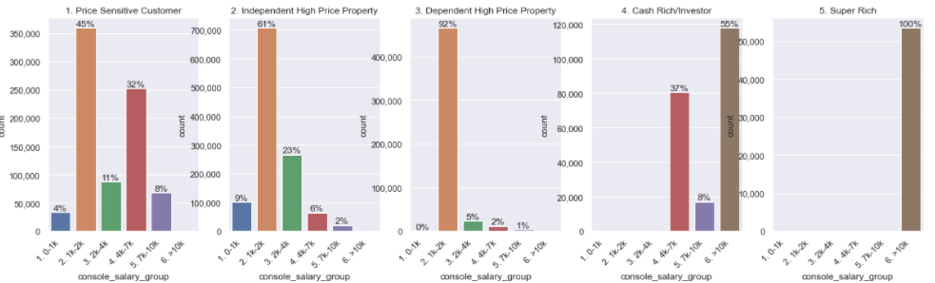
7.0 5 Profile analysis
expense
salary

Slide 36
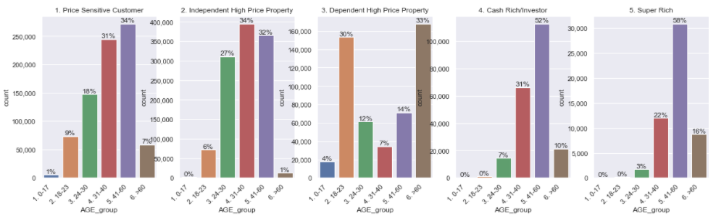
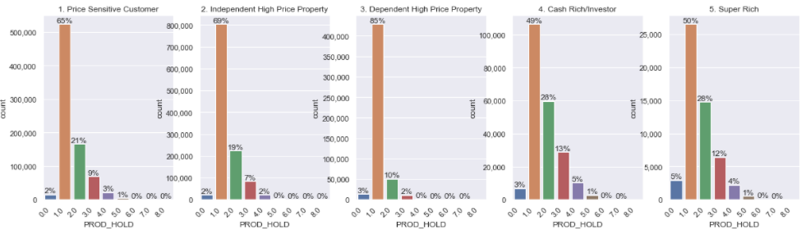
7.0 5 Profile analysis
Age
Product Holding

Slide 37
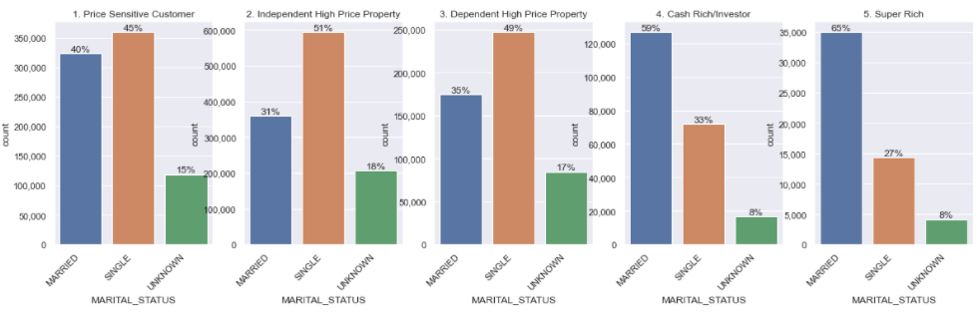
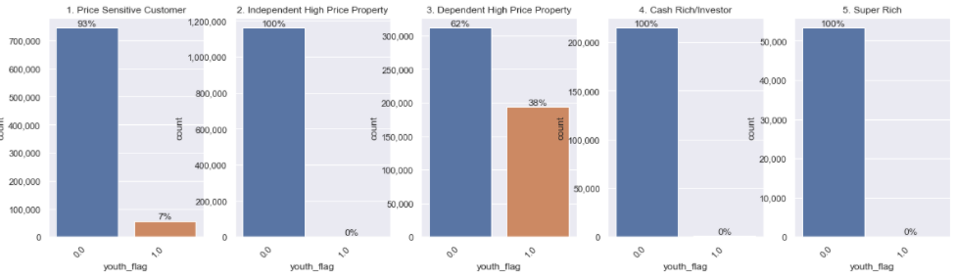
7.0 5 Profile analysis
Marital Status
youth

Slide 38
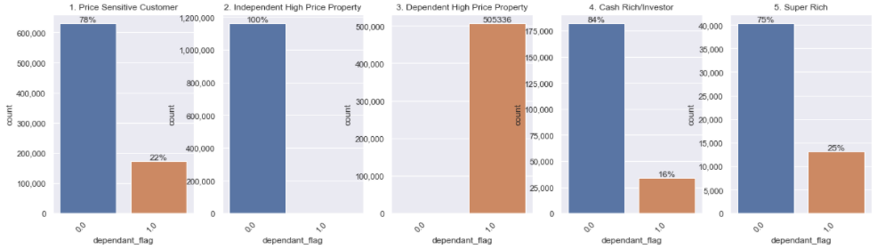
7.0 5 Profile analysis
Dependant

Slide 39
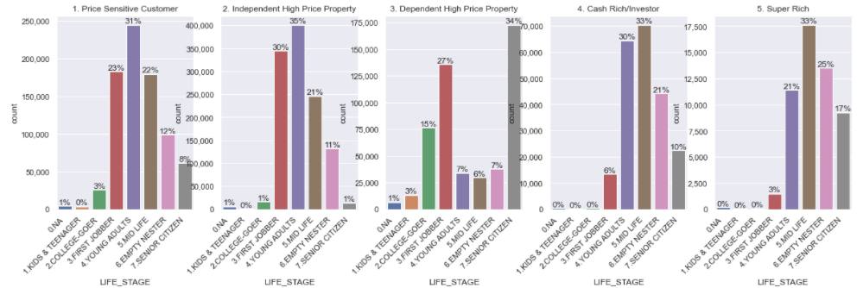
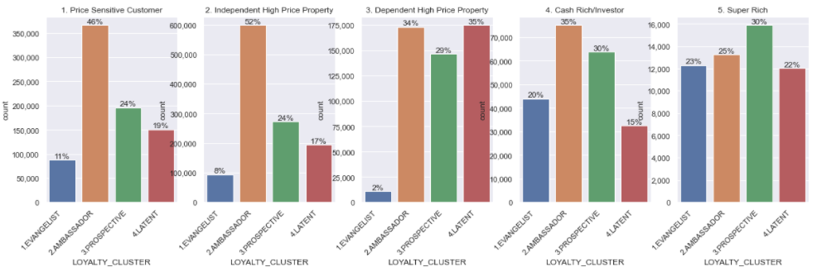
7.0 5 Profile analysis
Life Stage
Loyalty Cluster

Slide 40
Dependent
Segment2 | income_cat | dependant_flag | 1. < 310K | 310k-765k | 5. >765k | 0. NO PRICE | Grand Total
MASS | B40 | 0 | 347518 | 847428 | 226009 | 331257 | 1752212
 |  | 1 | 132308 | 366959 | 122282 | 136665 | 758214
 | M40 | 0 | 86977 | 281008 | 85457 | 77907 | 531349
 |  | 1 | 10739 | 40062 | 16095 | 12440 | 79336
 | T20 | 0 | 18118 | 76645 | 40269 | 21782 | 156814
 |  | 1 | 4037 | 18850 | 13134 | 6461 | 42482
 | UNKNOWN | 0 | 16166 | 46668 | 14039 | 20646 | 97519
 |  | 1 | 1880 | 5772 | 2003 | 2763 | 12418
HAB |  |  | 37796 | 163327 | 86456 | 43870 | 331449
Grand Total |  |  | 655539 | 1846719 | 605744 | 653791 | 3761793

Slide 41
Youth
Segment2 | income_cat | youth_flag | 1. < 310K | 310k-765k | 5. >765k | 0. NO PRICE | Grand Total
MASS | B40 | 0 | 424622 | 1068596 | 300598 | 421941 | 2215757
 |  | 1 | 55204 | 145791 | 47693 | 45981 | 294669
 | M40 | 0 | 97259 | 319636 | 100976 | 89926 | 607797
 |  | 1 | 457 | 1434 | 576 | 421 | 2888
 | T20 | 0 | 22065 | 95249 | 53278 | 28172 | 198764
 |  | 1 | 90 | 246 | 125 | 71 | 532
 | UNKNOWN | 0 | 17531 | 50939 | 15593 | 22787 | 106850
 |  | 1 | 515 | 1501 | 449 | 622 | 3087
HAB |  |  | 37796 | 163327 | 86456 | 43870 | 331449
Grand Total |  |  | 655539 | 1846719 | 605744 | 653791 | 3761793

Slide 42
Income
income_cat | console_income_grp | 1. < 310K | 310k-765k | 5. >765k | 0. NO PRICE | Grand Total
B40 | 01. <RM3K | 424933 | 1067211 | 308570 | 421487 | 2222201
 | 02. RM3K - <RM4K | 54893 | 147176 | 39721 | 46435 | 288225
M40 | 03. RM4K - <RM5K | 45871 | 136456 | 39833 | 41385 | 263545
 | 04. RM5K - <RM7K | 34731 | 116749 | 36366 | 31651 | 219497
 | 05. RM7K - <RM9K | 15941 | 62882 | 23505 | 16200 | 118528
 | 06. RM9K - <RM11K | 1173 | 4983 | 1848 | 1111 | 9115
T20 | 06. RM9K - <RM11K | 5909 | 26338 | 12038 | 6713 | 50998
 | 07. RM11K - <RM15K | 5321 | 26016 | 13815 | 6807 | 51959
 | 08. RM15K - RM20K | 2687 | 13565 | 9240 | 3798 | 29290
 | 09. >RM20K | 8238 | 29576 | 18310 | 10925 | 67049
UNKNOWN | NIL | 18046 | 52440 | 16042 | 23409 | 109937
 |  | 37796 | 163327 | 86456 | 43870 | 331449
 |  | 655539 | 1846719 | 605744 | 653791 | 3761793

Slide 43
7.0 Used Case – Potential Affluent
Low Price
< RM310K
Middle Price
RM 310K – RM 765K
High Price
> RM 765K
479,826 (15.44 %) | 1,214,387 (39.07 %) | 348,291 (11.21 %)
97,716 (3.14 %) | 321,070 (10.33 %) | 101,552 (3.27 %)
22,155 (0.71 %) | 95,495 (3.07 %) | 53,403 (1.72 %)
MASS
(B40)
MASS
(M40)
MASS
(T20)
Dependent Flag | Criteria/Logic
STUDENT | - Age <16 - Self-declared as Student or without Occupation, no income, age < 25 - Age < 25, no income, supplementary cc holder or with yippie account (as kid)
RETIREE/PENSIONER | - Age >= 60 and no income - Self-declared as Retiree/Pensioner or without Occupation, no income, age >= 55
HOMEMAKER | - Self-declared as Homemaker or without Occupation, no income - Age >= 16, married, no income, supplementary cc holder
Around 18.4% (503,246 out of 2,733,895) belong to Potential Affluent segment where this group of customer are staying in High Price Property

